Slide 1
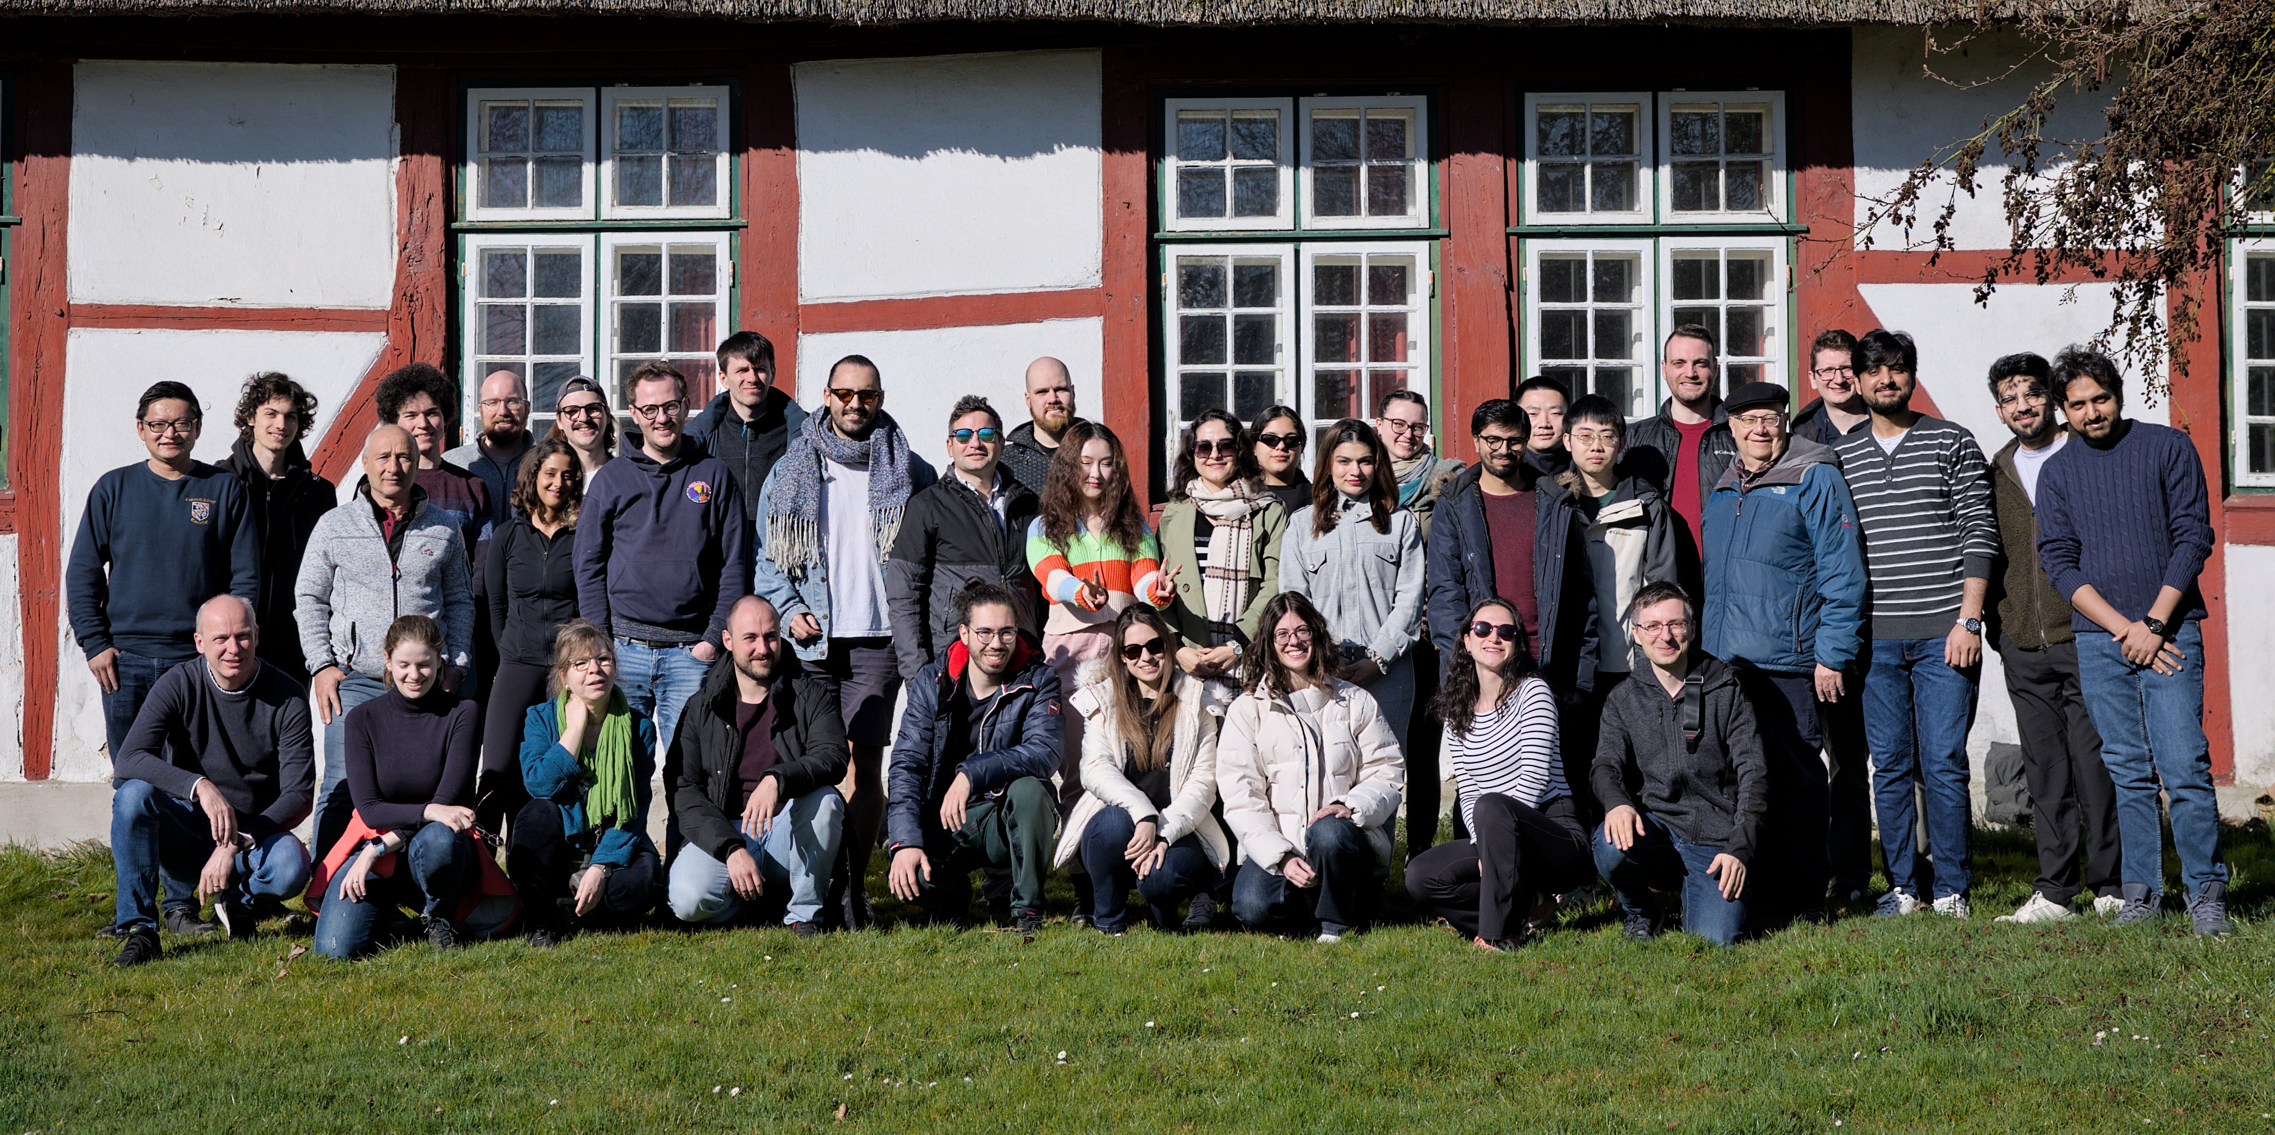
Telecommunication Networks Group (TKN)
Falko Dressler | Telecommunication Networks

Slide 2
Team
Professor
Prof. Dr.-Ing. habil. Falko Dressler
Emeritus Professor
Prof. Dr.-Ing. habil. Adam Wolisz
Senior Researchers
Dr. Jorge Torres Gómez
Dr. Anatolij Zubow
Team assistant
Petra Hutt
Lab engineer
Georgios Ainatzes
Ahmad Farhad Shams
Scientific Staff
Joana Angjo
Ahmed Hasan Ansari
Jamshid Bacha
Osman Tugay Başaran
Dr. Sunasheer Bhattacharjee
Tehmina Bibi
Lisa Y. Debus
Sigrid Dimce
Dr. Doğanalp Ergenç
Christos Laskos
Dr.-Ing. Agon Memedi
Fabian Missbrenner
Marie-Christin H. Oczko
Dr. Saswati Pal
Atefeh Rezaei
Sascha Rösler
Peter Scheepers
Simon Schmitz-Heinen
Lukas Stratmann
Youming Tao
Ziqi Zhou
External PhD Candidates
Laura Finarelli
Mohammad Bariq Khan
Mengfan Wu
Student Research Assistants
Ahmed Abdulfattah
Aikaterini Kerani
Negin Masoudifar
Lorenz Pusch
Jakob Rühlow

Slide 3









Research Focus
Next Generation Wireless Communications
Beyond RF / Molecular Communication
Intelligent Edge Computing and Mobile Systems
Machine Learning and Networking
Modeling, simulation, and experimentation

Slide 4
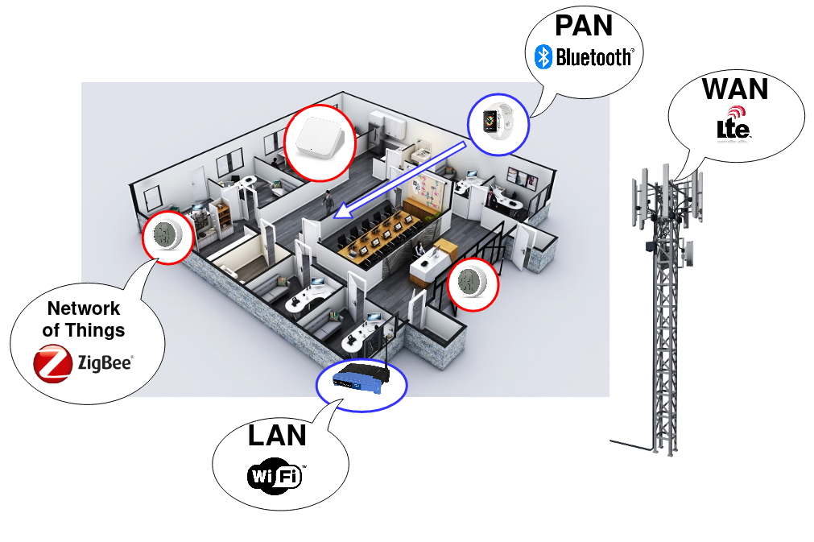
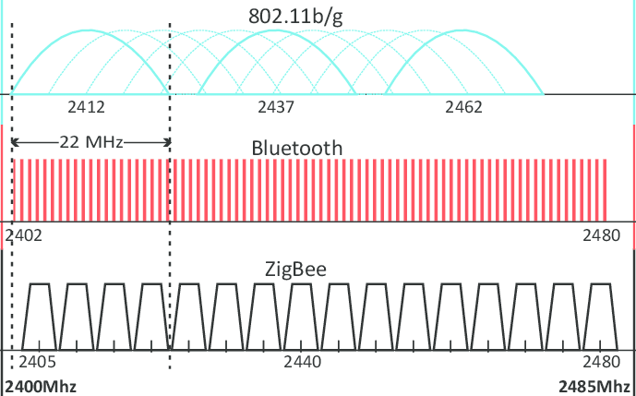
Next Generation Wireless Communications
From Coexistence to Collaboration in unlicensed spectrum bands
  Self-organization and self-adaptation
  Cross-Technology Communication (CTC)
Reflective Intelligent Surfaces (RIS)
  Co-existence and interference management
  Resource allocation
Joint communication and sensing
  Channel sounding using channel splicing
  mmWave and Terahertz communication
Localization using RF signals
  WiFi Fine Time Measurements
  Multi-sensor fusion

Slide 5
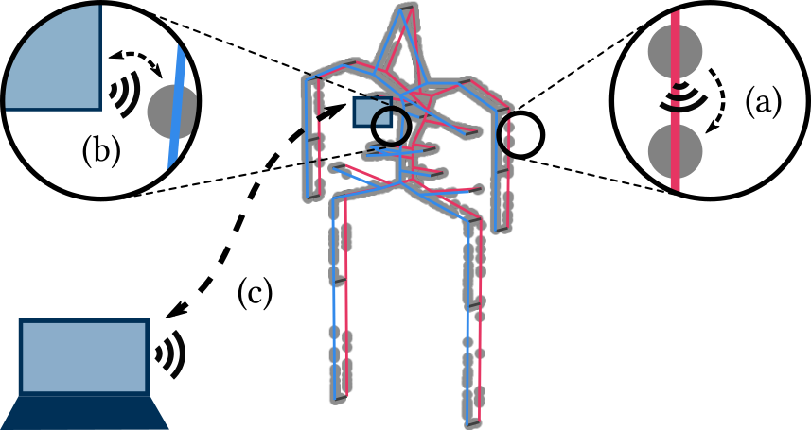
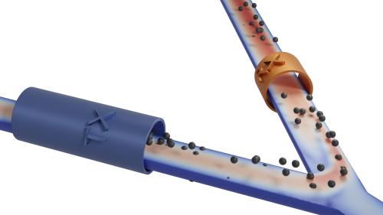
Beyond RF / Molecular Communication
Nano communication
  From in-body nano communication to body area networks
  Ultrasound and particle dispersion as alternatives to
  electromagnetic communication
  Terahertz in-body communication
Internet of Bio-Nano-Things
  Molecular communication
  Abnomaly detection
Simulation and modelling
  Human circulatory system modeling
  Markov models

Slide 6
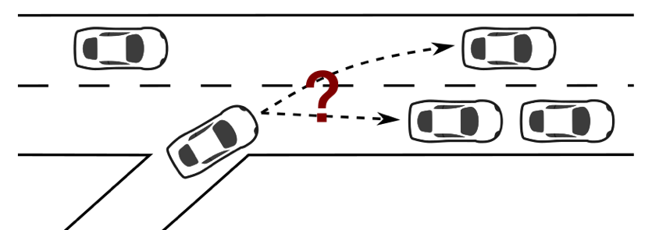
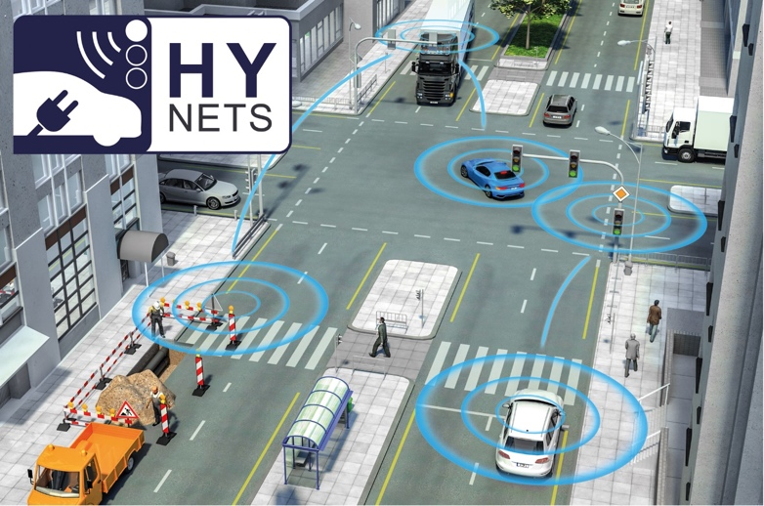
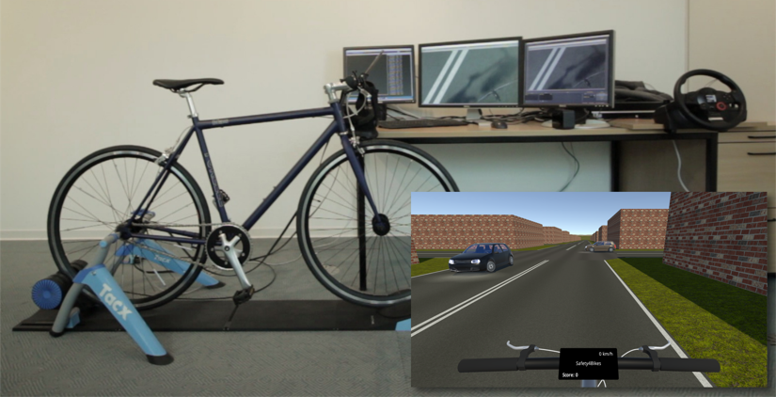
Intelligent Edge Computing and Mobile Systems
Virtualized edge computing (V-Edge)
  Supporting classic MEC in 6G networks
  Vehicular micro clouds
Safety systems for Vulnerable Road Users
  Cooperative collision avoidance
  Human-in-the-loop testing
  Virtual cycling environment (VCE)
Platooning (= Vehicle Convoys)
  Adaptive heterogeneous communications
  Optimal platoon formations
Holistic V2X Simulation
  Real-time V2X simulation
  Connected electric mobility

Slide 7
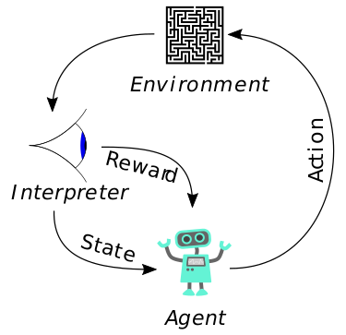
Machine Learning and Networking
Networks have evolved into complex & dynamic systems
  No. of knobs to be optimized are huge in WiFi and LTE standards
  Unconventional approaches needed to master the
  complexity of control & management
Machine Learning
  Reinforcement Learning promising for hard problems
  like co-existence of heterogeneous technologies
  Asynchronous distributed and federated learning
  Transfer learning to connect simulation and real world
Open AI Gym-based Toolkits
  ns3gym (network simulation), grGym (software defined radio), VeinsGym (intelligent transportation systems)

Slide 8
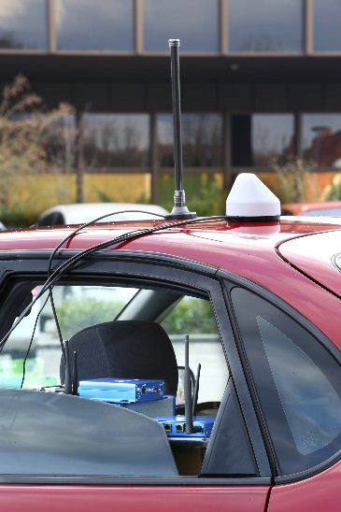
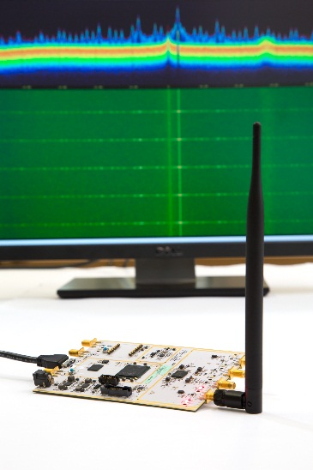

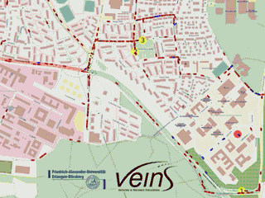
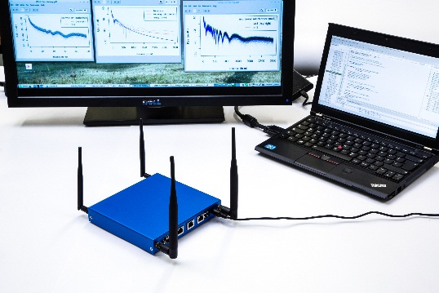
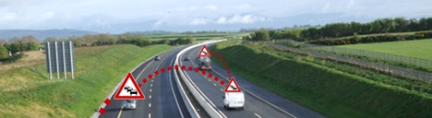
Research Methodology
Simulation-based Performance Evaluation
  Vehicular networking: Veins, Plexe
  Integrating vulnerable road users: VCE
  Molecular communication: BloodVoyager BVS-C
Real-world Experiments and Field Tests
  COTS platform-based measurements
  Standard-conform field tests: OpenC2X
  Matlab and GNU Radio models
AI/ML: ns3gym, grGyn, VeinsGym

